Slide 1
The Rig on this End is Homebrew!
OR
When you know stuff you can do stuff!
Pete Juliano, N6QW, June 11, 2020 Presented to the Cedar Valley ARC, Cedar Rapids, IA
1

Slide 2
Get to Know Pete, N6QW
Licensed for 61 years. When I started in this magical hobby a 100 watt
transmitter was two 19” relay racks of equipment with one of the racks
dedicated to just the power supplies. In the 1960’s when I studied EE, at
Penn State, Solid State Electronic Courses were optional.
Most of my 30 years of work experience was in Aerospace. Spent 11 years
in St Louis; but most of those 30 years was in management not hardware.
Retirement in 1997 gave me the time to play with the electrons and I
haven’t stopped!
2

Slide 3
The IARU several years ago stated hams are hams because:
They Love to Contest.
They Love to Operate.
But I think they are partially WRONG as there are many of us
who “Love to Build” our stations beyond just Antennas, Accessories
or Linear Amplifiers.
True we are in the minority; but we only need to reflect on hams
like Gene Senti * and Gerald Youngblood! These builders turned
their creations into some of the finest ham gear we have ever
known. Burdick and Swartz (Elecraft) built homebrew stuff first!
* The Collins Engr who designed the KWM-1 in his basement.
3

Slide 4
Today’s Rigs have become very technical!
Recently I was told by a ham I was 10 Hz low in
Frequency. He had a GPS linked to a Rubidium
Frequency Standard on his FLEX 6700
Digital Frequency Readouts (PLL’s/DDS/DDC)
Digital Signal Processing/Noise Reduction
All Band, All Mode, the Digi-Stuff
Choices of Receive Bandwidths
Waterfalls & Spectrum Displays
Embedded Computers
4

Slide 5
I can see the eye’s rolling and the heads shaking!
The question remains: Could you build such a radio in your shack?
I am not talking about a kit project; but something Scratch
Built that is a result of today what I call “Technology Leverage”.
There are inexpensive electronic building blocks that are readily
available at low cost. How about a highly accurate and stable
Digital VFO built with parts from Amazon –cost $20? Consider
an embedded computer for $35 (Amazon). Two Double Balanced
Mixers can be had for $11 from Mouser. Did I mention free software?
5

Slide 6
One of My Goals is to foster Homebrew Construction!
Early on hams didn’t have computers, could not do an Internet
Search, no credit cards and therefore no two days later the
Amazon truck shows up at the front door. Those OM’s were the
tinker types, scroungers and innovators for they hand built their
stations. There was a pride in announcing to the ham at the other
side of the QSO: “The Rig on this End is Homebrew!”
We live in the Golden Era of Homebrew with vast amounts of
cheap technology close at hand. But it takes the “knack”.
Todays counter argument; I can’t build a FTdx101M!
6

Slide 7
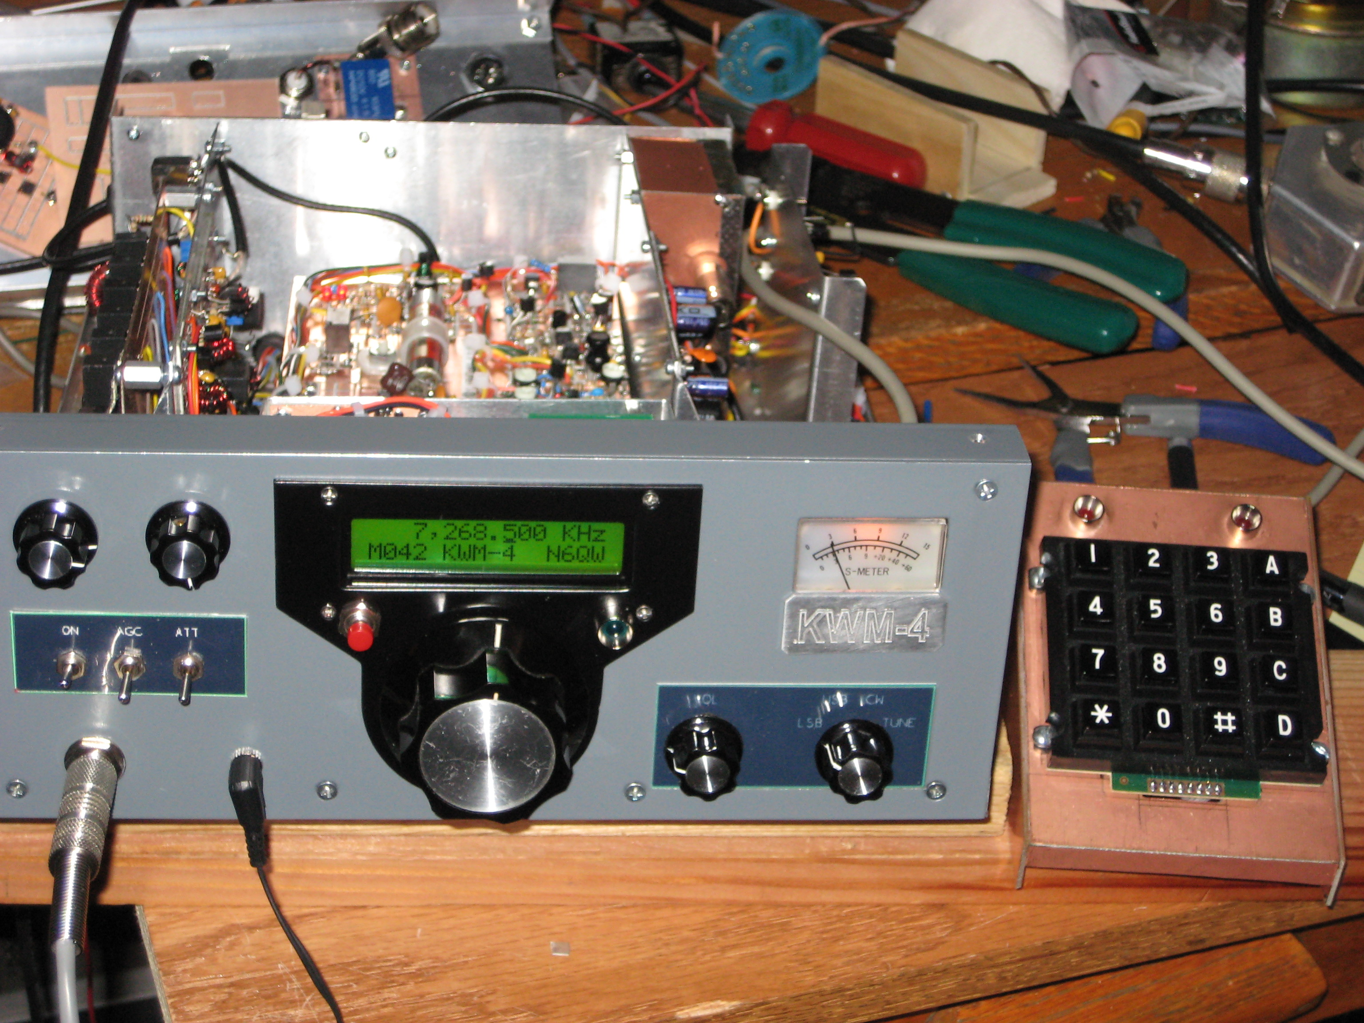
That is true … But you could build this ~ A KWM-4
7

Slide 8
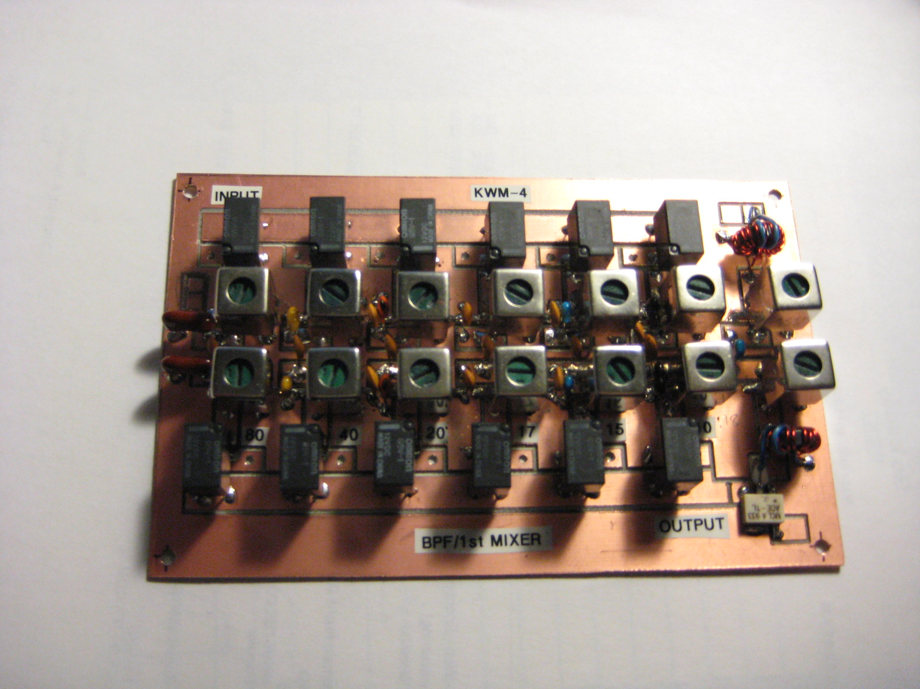
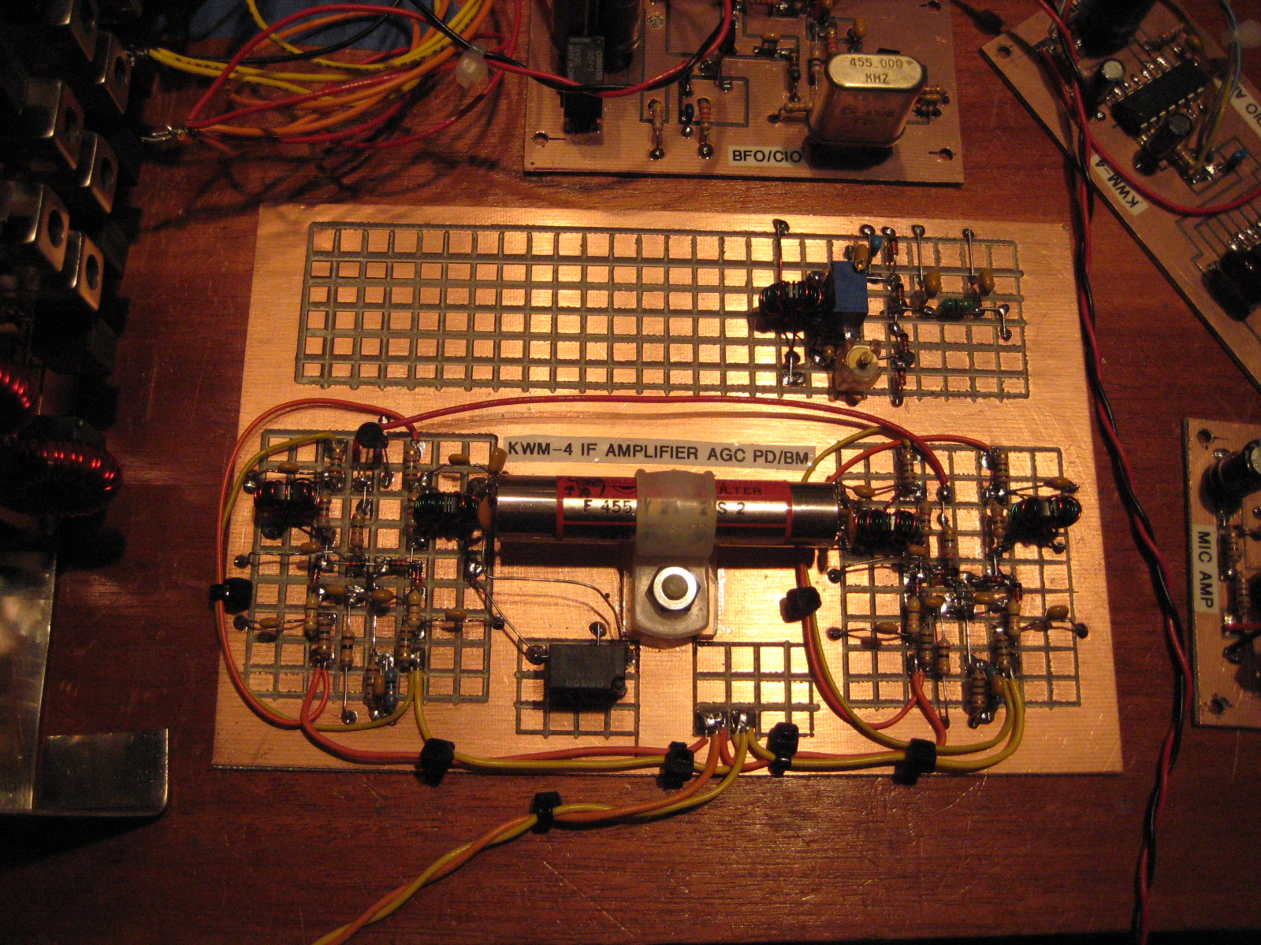
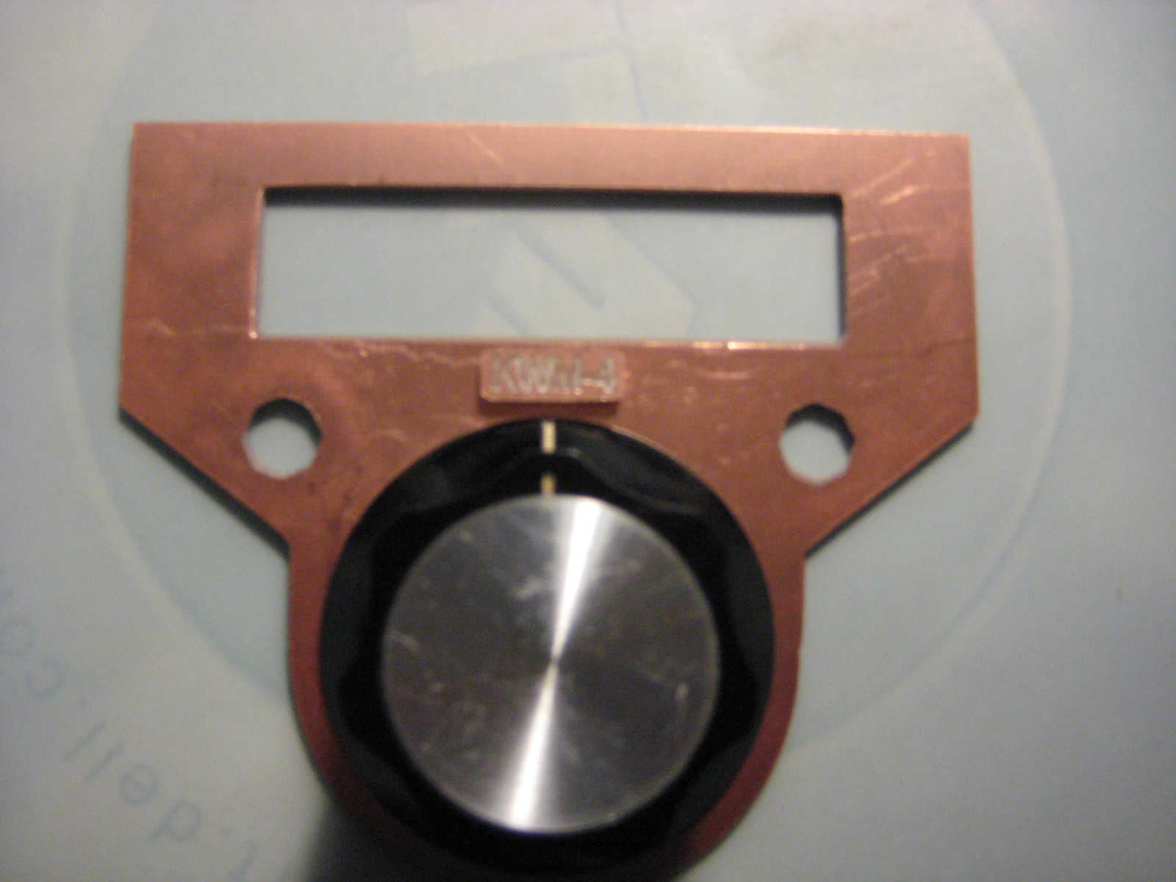
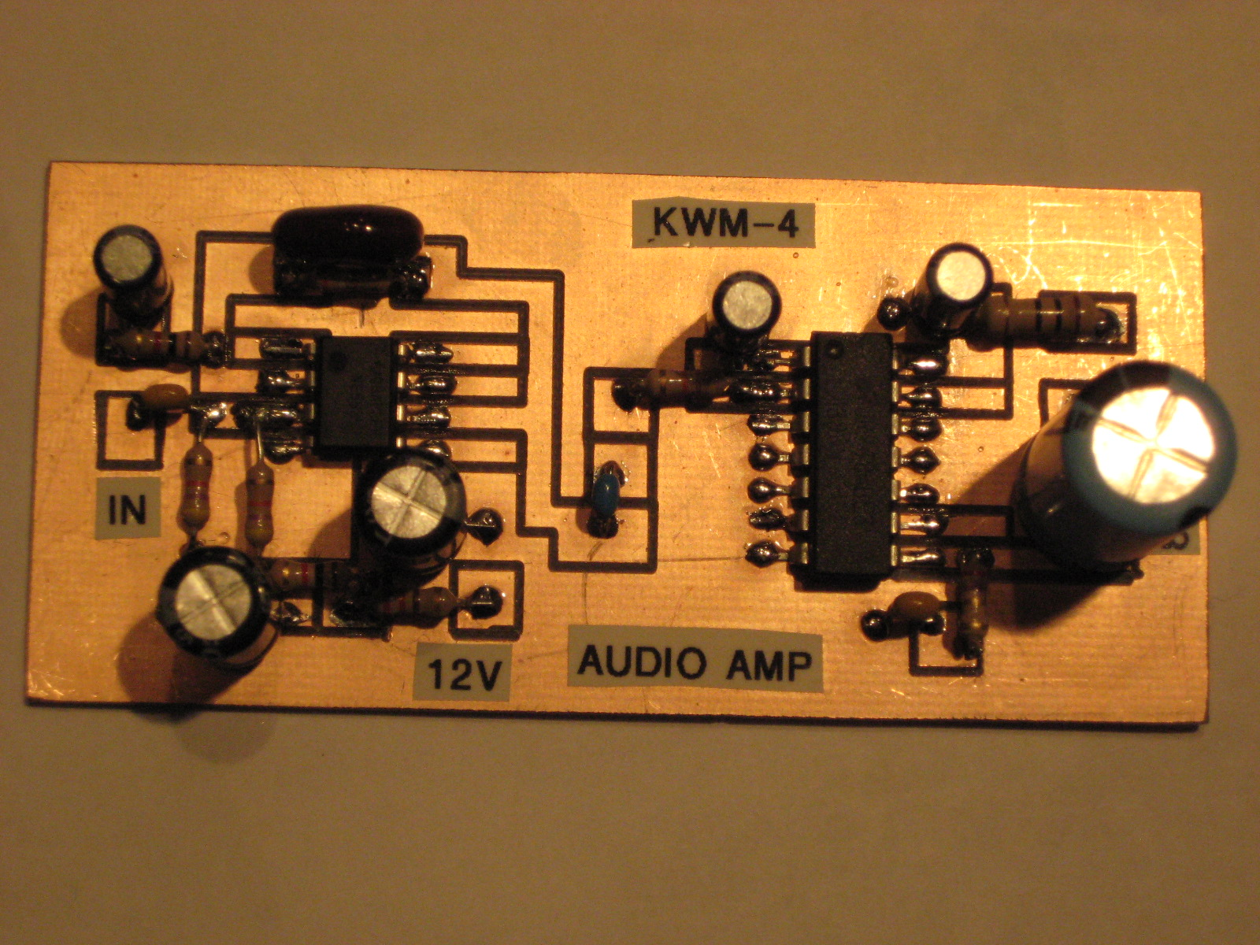
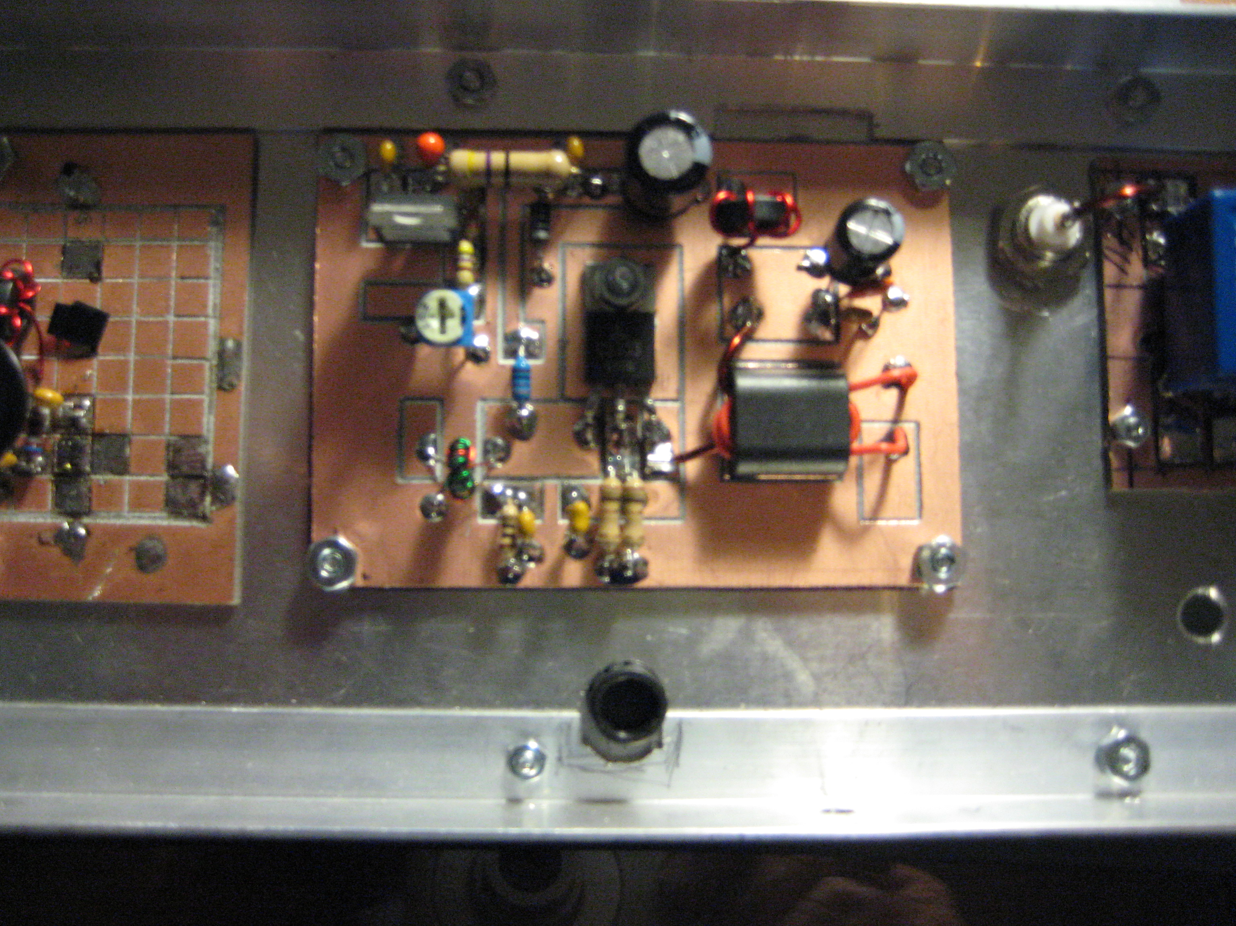
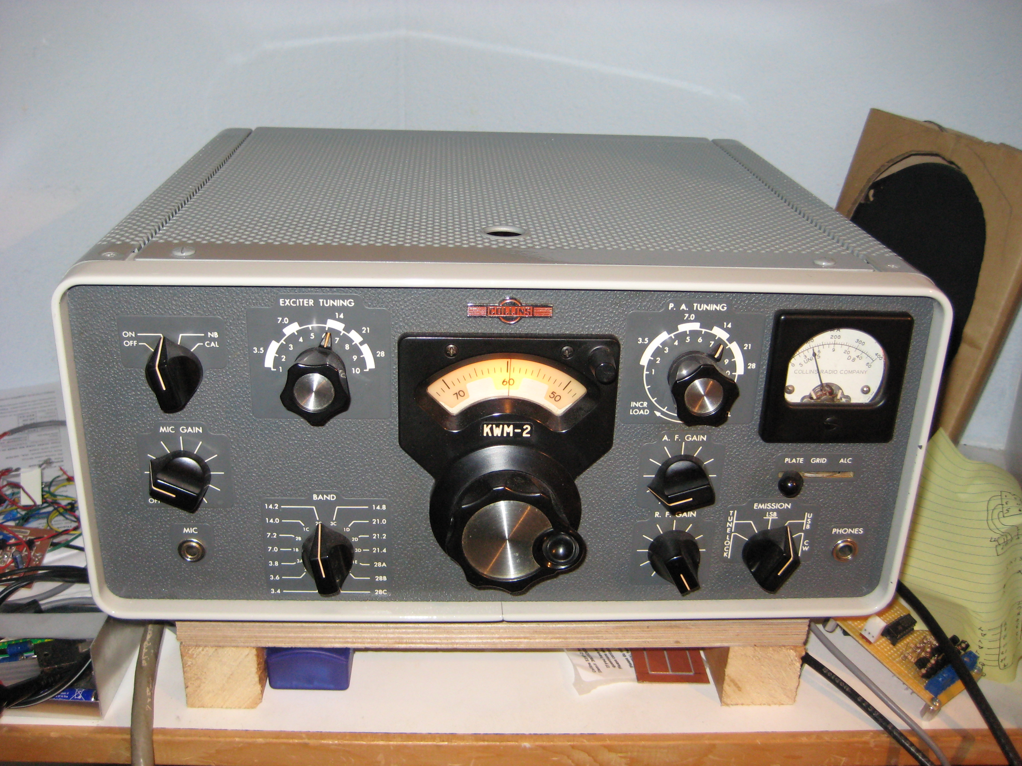
8

Slide 9
In 2012, I spotted a project built in the early 1960’s called the LMW3
where two hams (In 8 Land) essentially built a cross between a KWM1
and a KWM2. It was a vacuum tube design that covered two hundred
kHz slices of the ham bands. I concluded it was a very excellent project,
as it used an ARC-5 tuning capacitor in the VFO. The Gold Standard!
The LMW-3 was QRP level; but had a pair of 4-125’s in the trunk.
After looking at the LMW-3, I asked why can’t I do the same; but in all
Solid State. Since mine also used a Collins Mechanical filter why not
call it a KWM-4. Basically it is a dual conversion, all band QRP SSB/CW
Transceiver (less 30M since the 1st IF is 10.7 MHz)
With a design/build team of one, I argued with myself quite a bit!
9

Slide 10
KWM-4 Highlights:
Dual Conversion 10.7 MHz and 455KHz
10.7 MHz Crystal Filter with a 10.245 MHz Conversion
Digital VFO with 999 Memories. Si570 /Microcontroller
Keypad with Up/Down Tuning like KWM380
Auto Switching of BPF’s LPF’s ~ Magic Decoder Ring
Three BFO Frequencies USB/LSB/CW
CW –Keyed Buffer Bypasses Mechanical Filter
Extensive use of CNC Milling of Parts/Boards
Separate Memory VFO for USB/LSB True Frequency
Three months to build versus the LMW 3 took 1 year
10

Slide 11
Well Actually – The KWM-4 is a Very Complex Project!
Not something everyone could do or can do.
One key element is my $250K CNC machine.
But more importantly it involved a process approach.
That last thing you do is turn on the soldering iron.
The first thing you do is a lot of “noodling” and building on
prior projects. My 2009 SS heathkit HW-101 Tri-Bander was
the base case for the KWM-4. See www.jessystems.com
But there is a simpler alternative ~ A Homebrew SDR Transceiver!
11

Slide 12
We are in the Transition from HDR to SDR!
The KWM-4 is mostly hardware ~ A Limitation
New SDR Designs are less Hardware Dependent
Upgrades typically involve Software changes
With tons of free software, less up front costs
Feature rich/new technology aspects
Unrivaled signal performance/capabilities
You not only hear the signal –you see it!
Visible Spectrum Slices
12

Slide 13
Homebrew SDR Transceiver Design Criteria
Sound Card Based I & Q Channel Approach
Initially a Single Band design ~ 40 Meters
Use of packaged hardware SDR-Kits Si570
Use of a Raspberry Pi3 or ASUS Tinker Board
Use of the ADE-1 DBM for the DCRs
J310 Bidirectional Amp, 2N2219 Driver, RF Power FET
QUISK Free SDR Software (N2ADR Design)
SSB /CW Keying via the SDR-Kits Controller
Club Project Approach
13

Slide 14
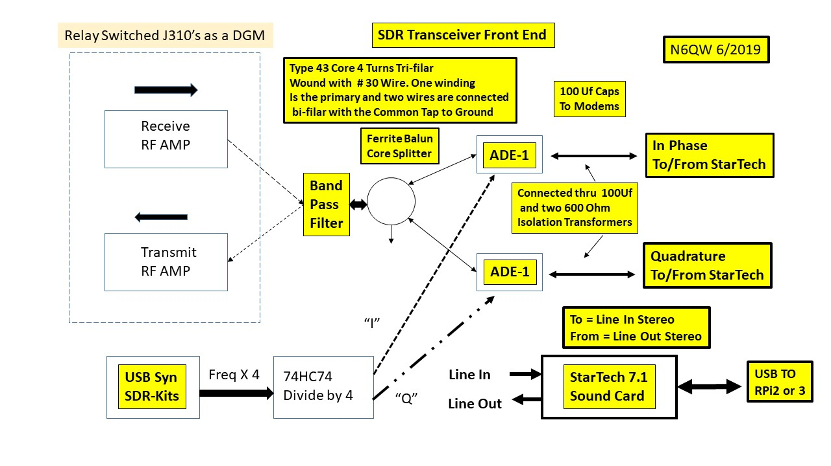
14

Slide 15
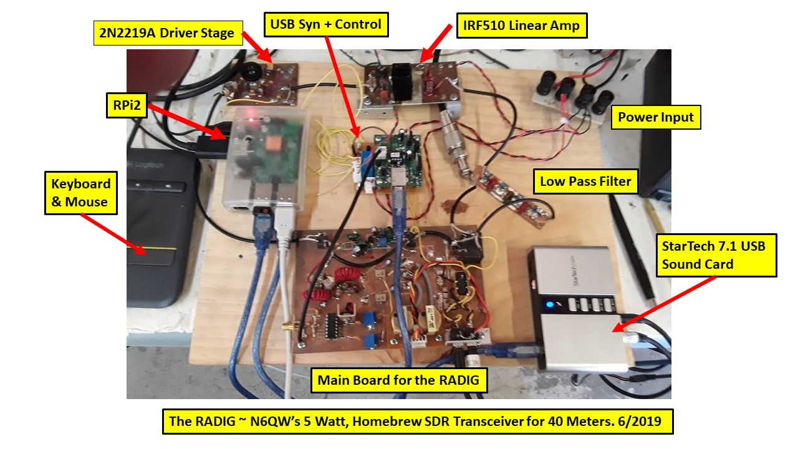
(Mitsubishi RD06HHF1)
(RPi3)
Now Optimal
Shop USB 2.0
6 Channel
Audio Dongle
UGREEN USB
Rev.: 6/2020
15

Slide 16
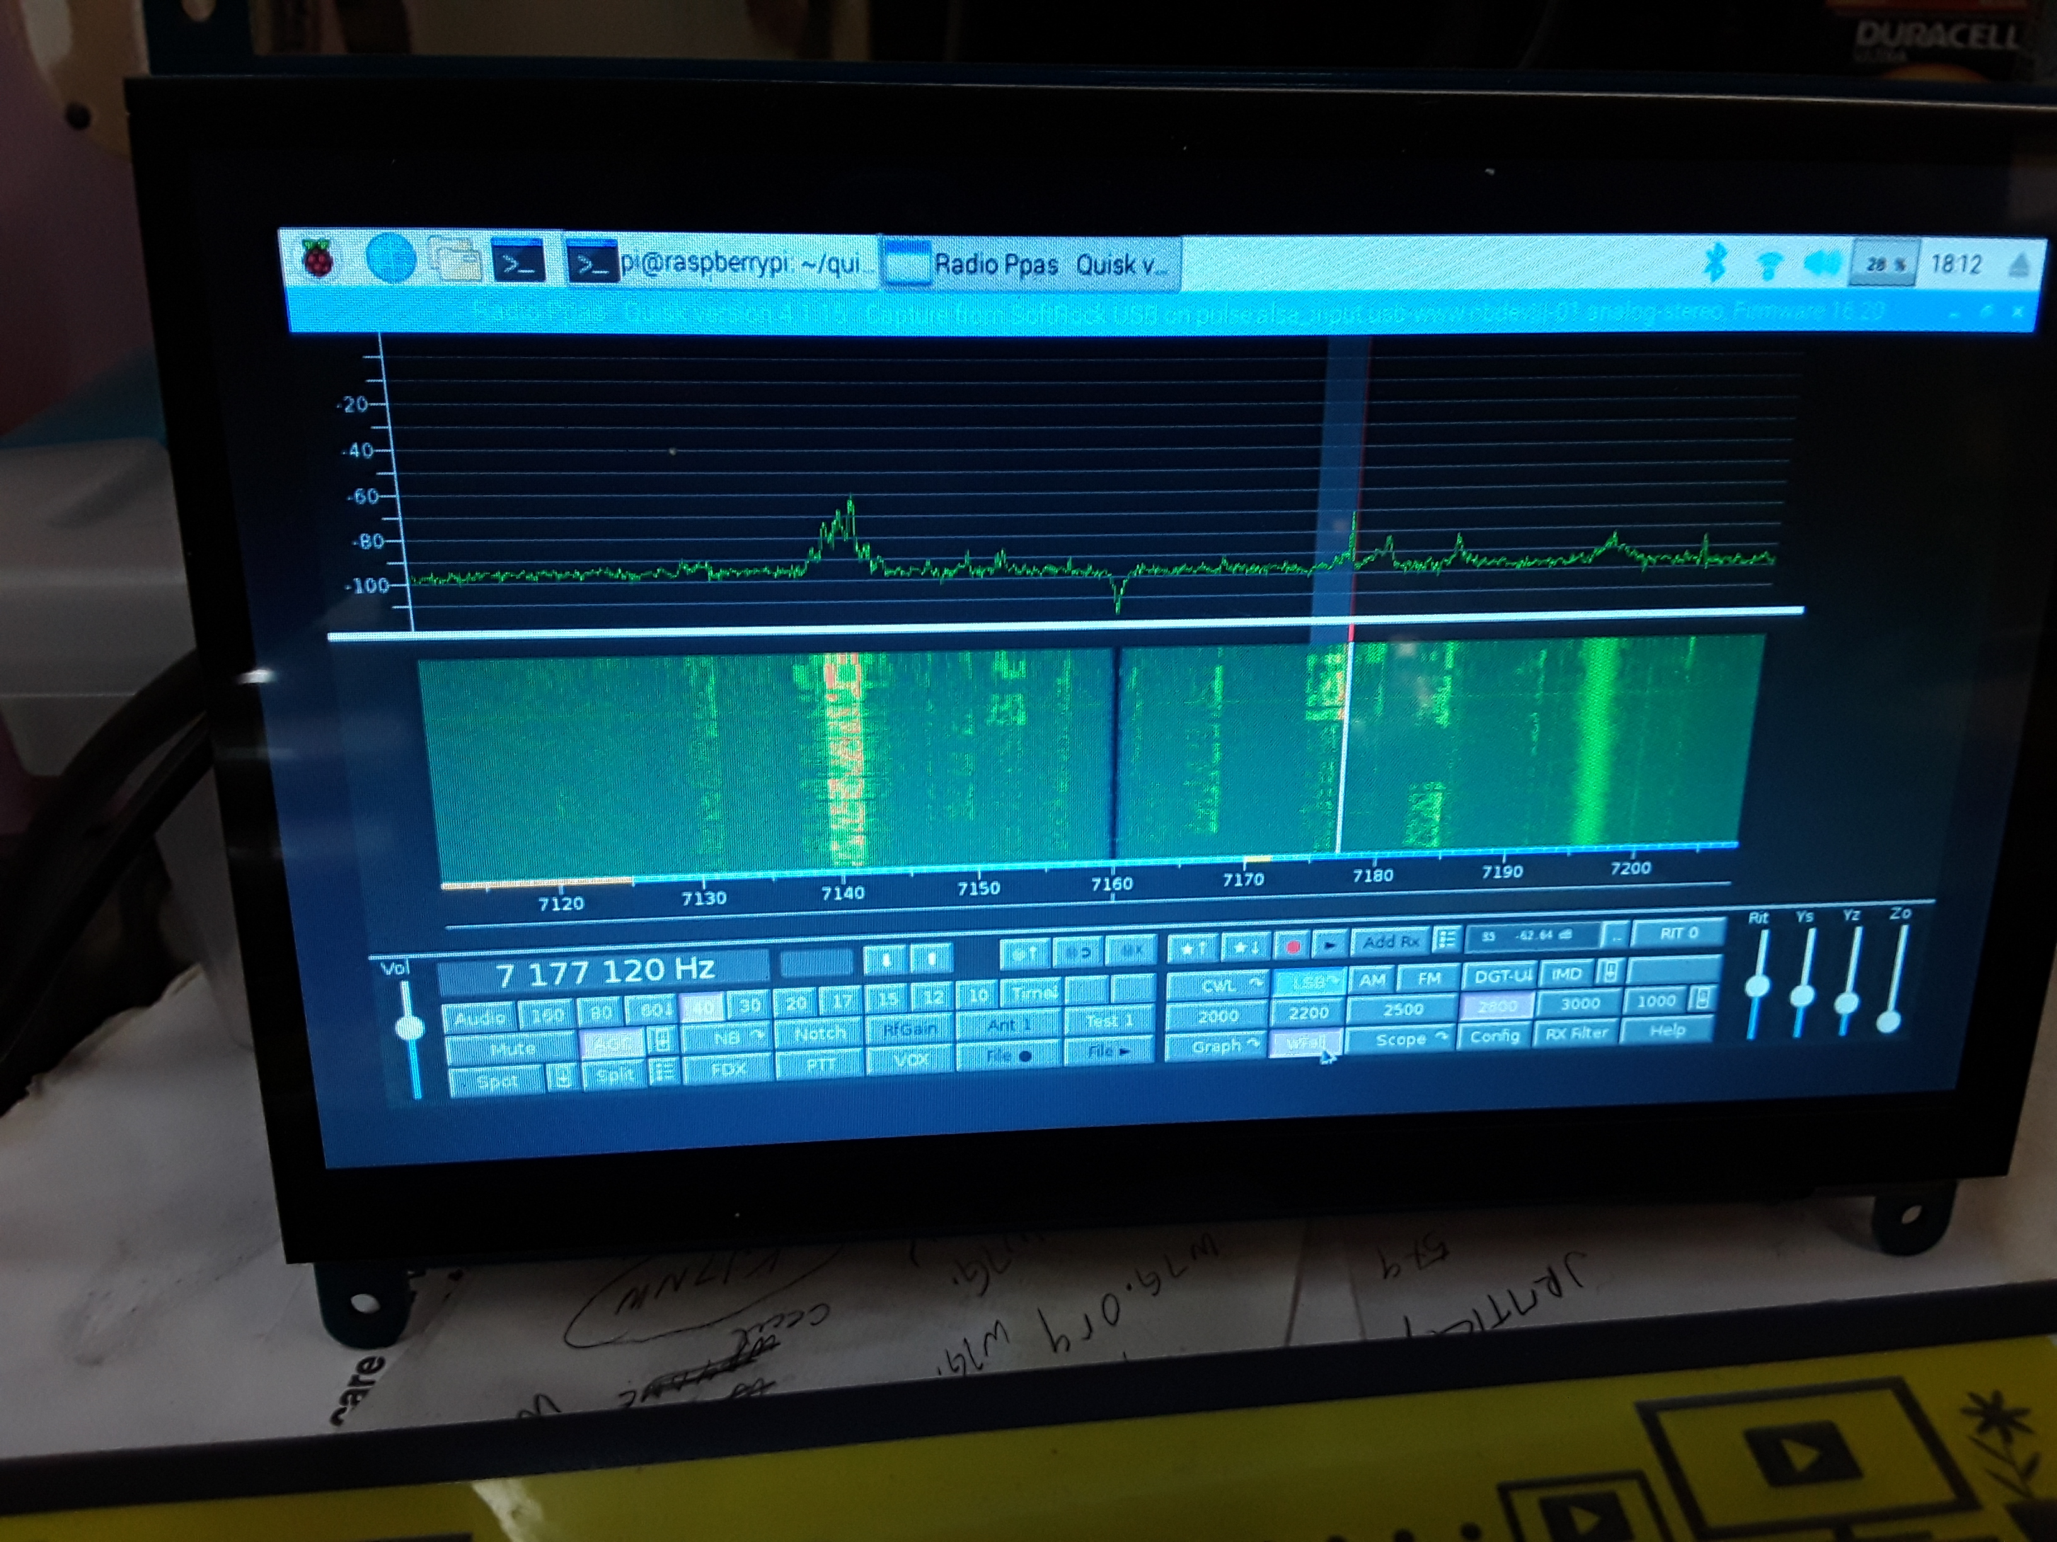
This is a 7” HDMI Display
Used with the RADIG Test
Bed SDR Transceiver.
With the RPI 3 and WSJTX
the RADIG works WSPR
and FT-8 directly.
(Note I designed a Digital
Interface that uses USB so
any rig with Upper Sideband
along with the RPi3 can do
WSPR and FT-8 using WSJTX.)
16

Slide 17
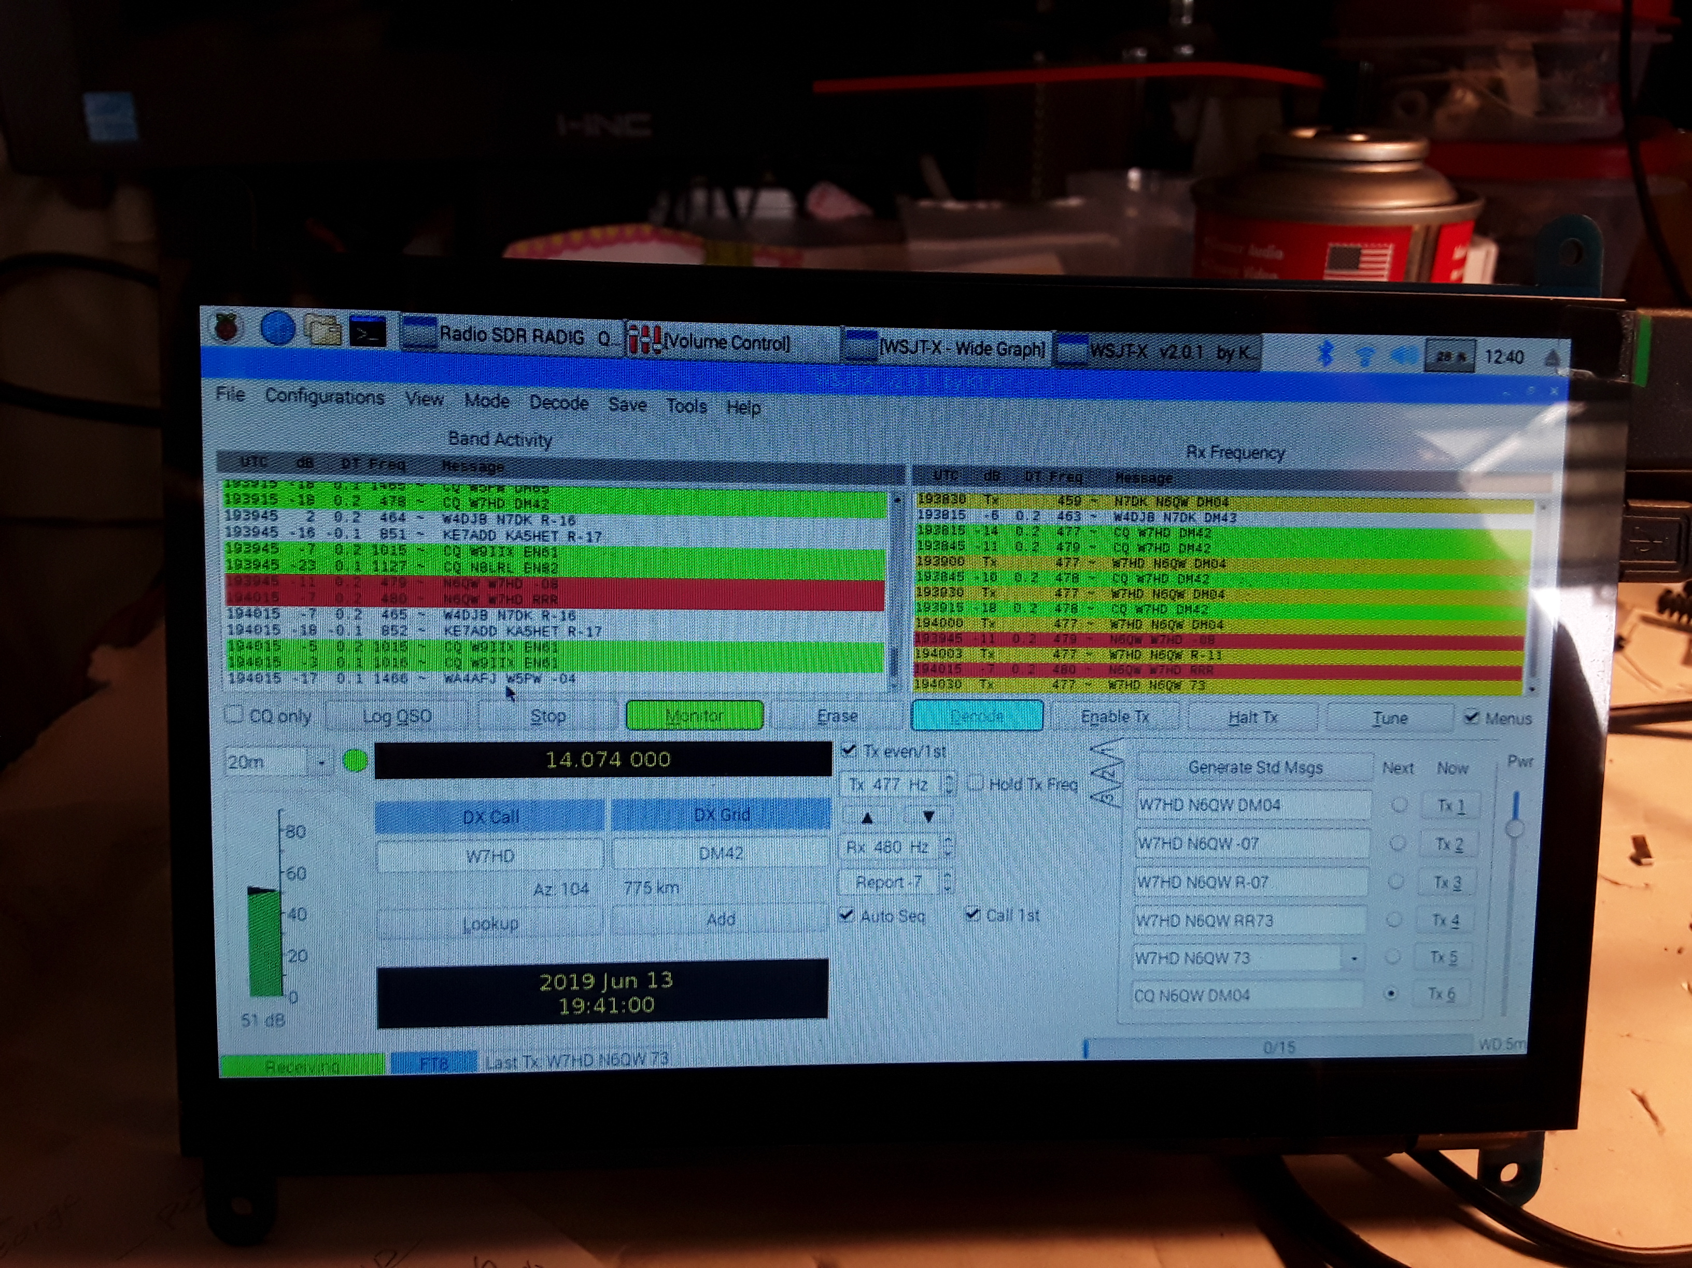
FT-8 With the RADIG
17

Slide 18
With some new powerful Microcontrollers you can have SDR on chip!
PJRC’s Teensy Microcontroller + CODEC ~ SDR on a Chip
Gives I and Q processing using Iowa Hills Software Hilbert Transforms
Design your own filters bandwidths
No Spectrum or Waterfall
Use the WebSDR Receiver sites for your Waterfall
Programs using the Arduino IDE’s
Pioneering work from ZL2CTM
Same Front End as used with the RPi3 or ASUS Tinker Board only no
computer required all on the Teensy.
18

Slide 19
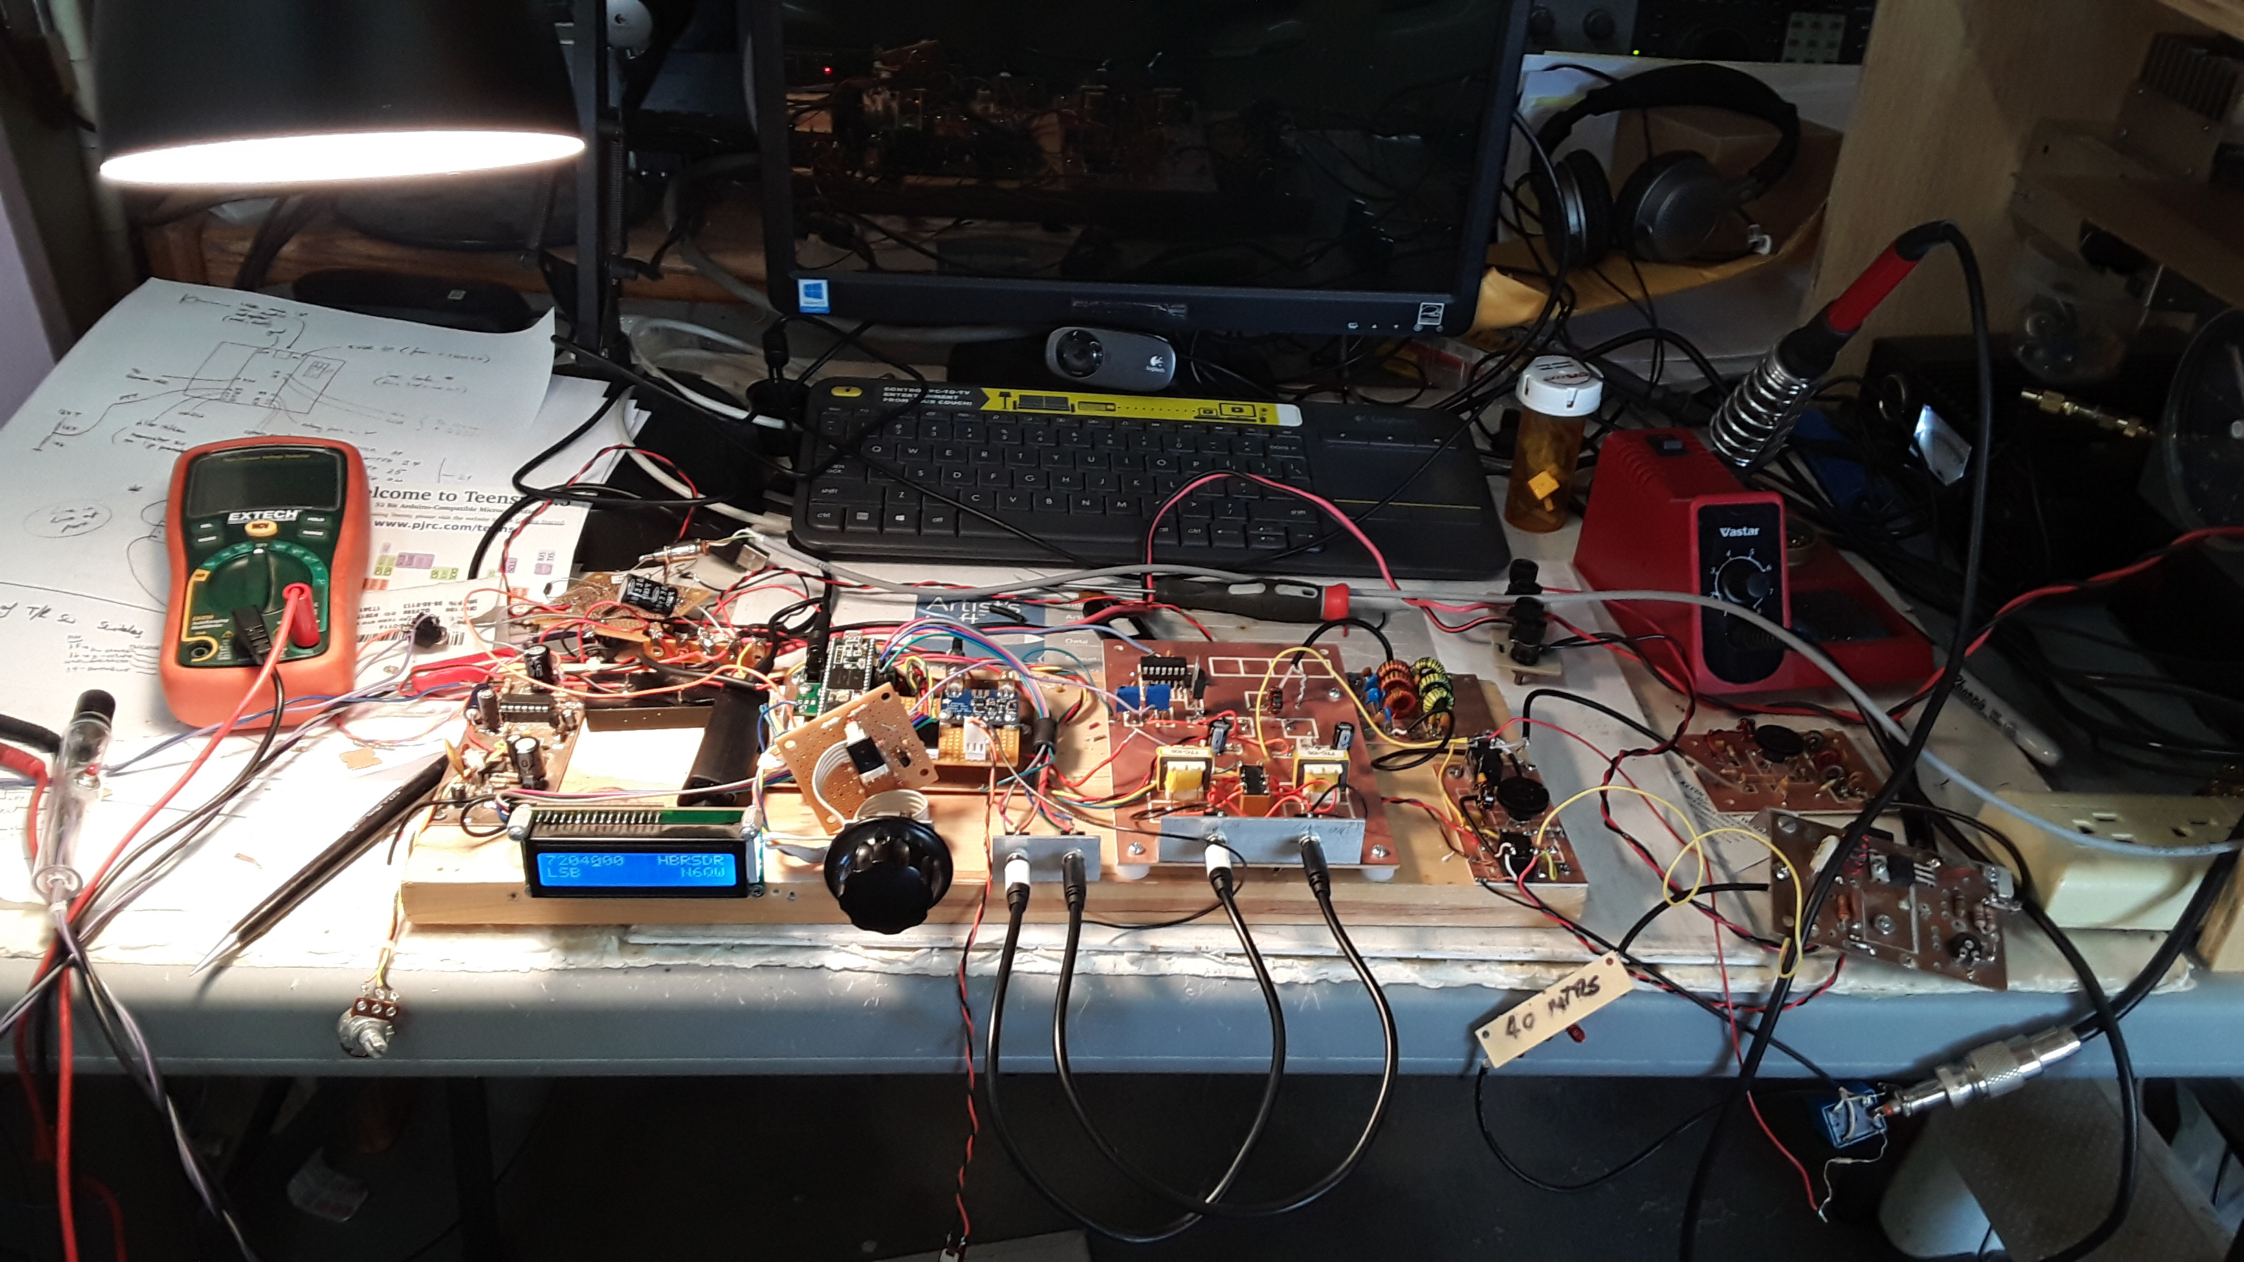
19

Slide 20
How good are the Homebrew SDR’s?
Simple Answer: Quite Good.
Not Much Hardware but the power is in the Software
QUISK is a full featured SDR Software and FREE!
You have choice of Bandwidths, all Modes and even
a recording function. You can run split and control
all facets of your received and some transmitted signals.
With the Si570 CMOS PLL, operation through 10 Meters.
20

Slide 21
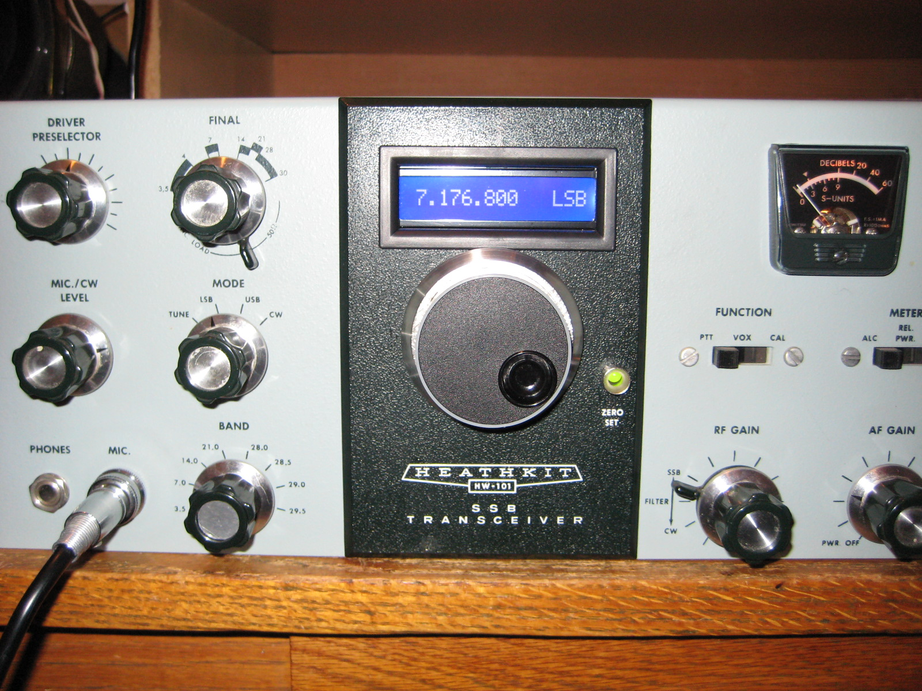
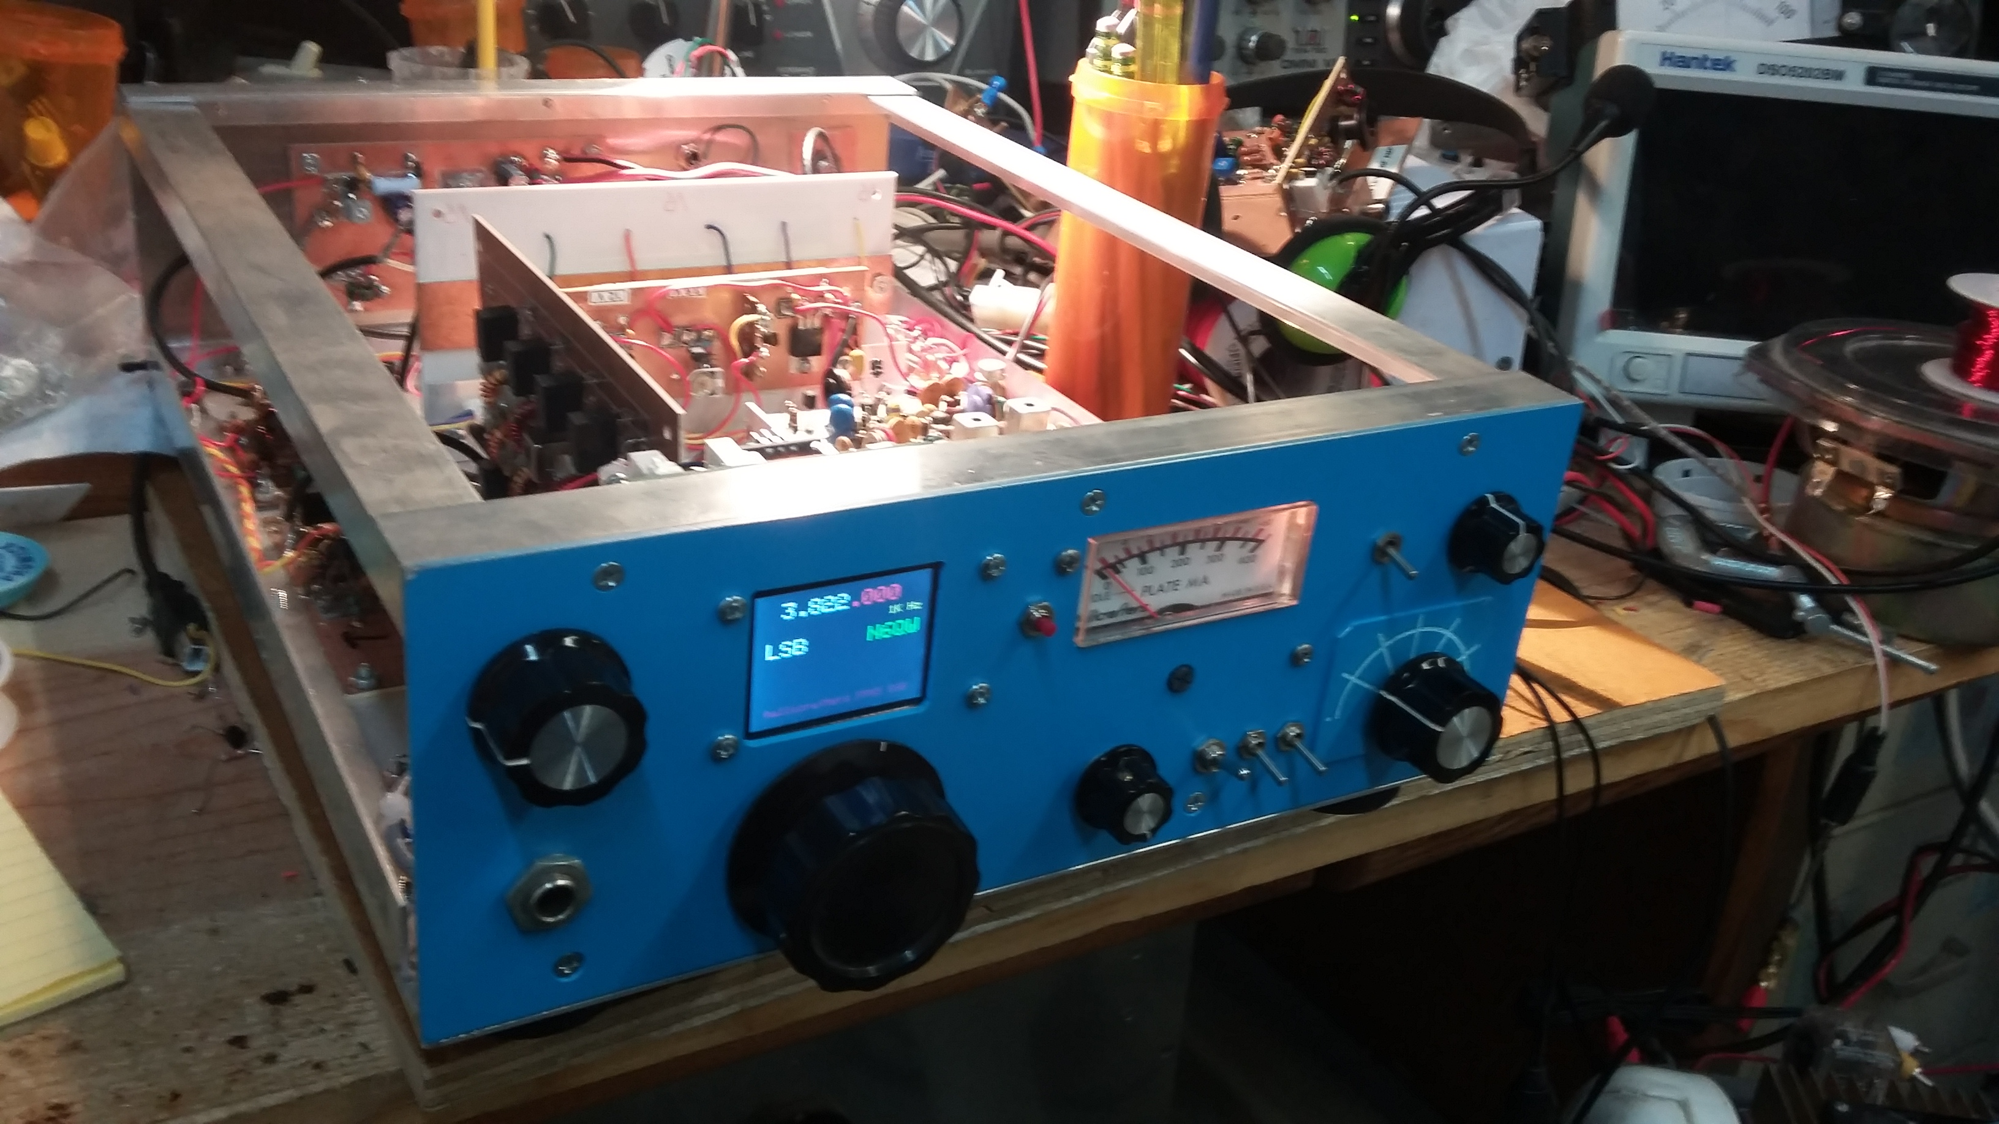
Homebrew Transceivers take many forms!
In the last 20 years I have “homebrewed” about three dozen Transceivers
Some are retrofitting older products with new technology like digital
displays, VFO stabilizers or complete repackaging (HW-101 FPM300)

Slide 22
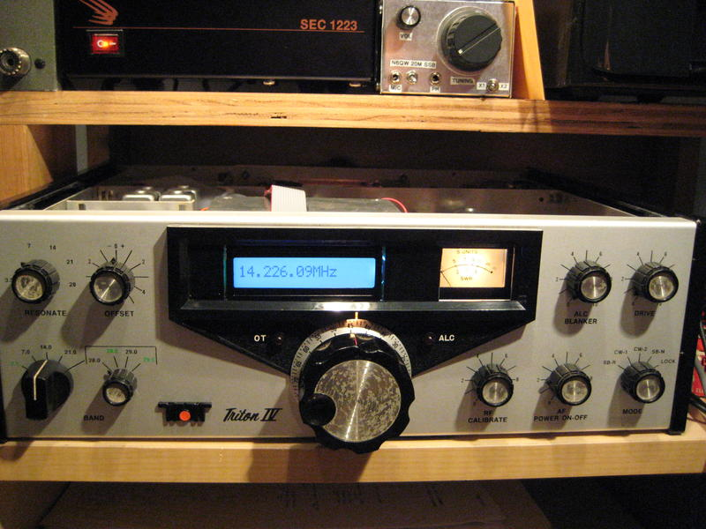
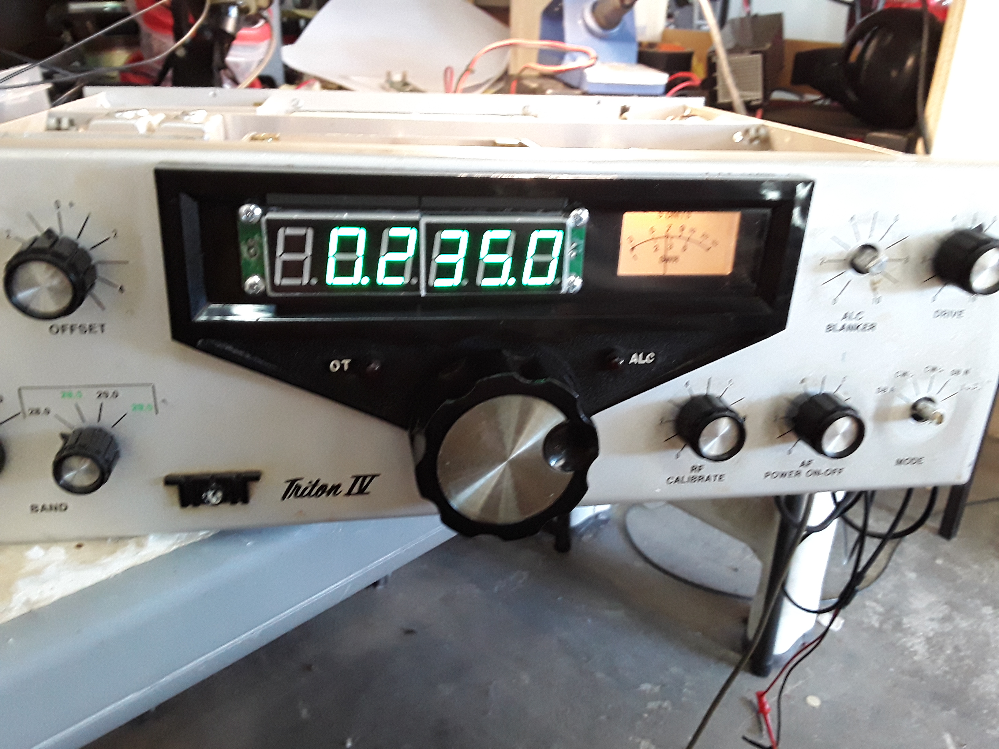
Below is a Ten Tec Model 540 (Analog) Converted to Digital 544
(Two different versions of the same conversion)

Slide 23
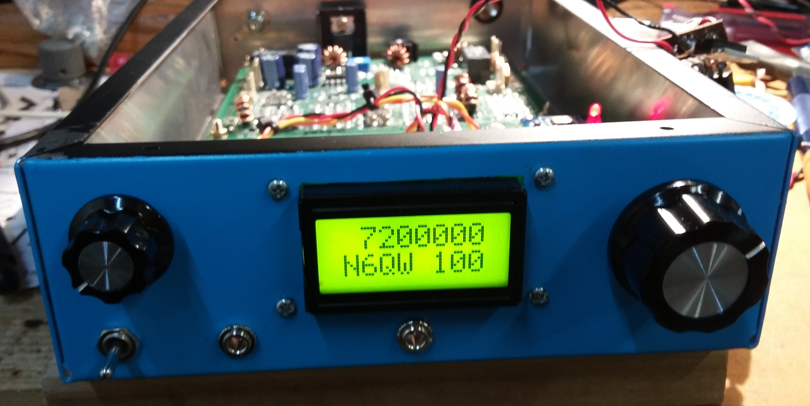
Some homebrew projects were just to test concepts…
An early Bitx40 before the Raduino. (8x2 LCD Display)

Slide 24
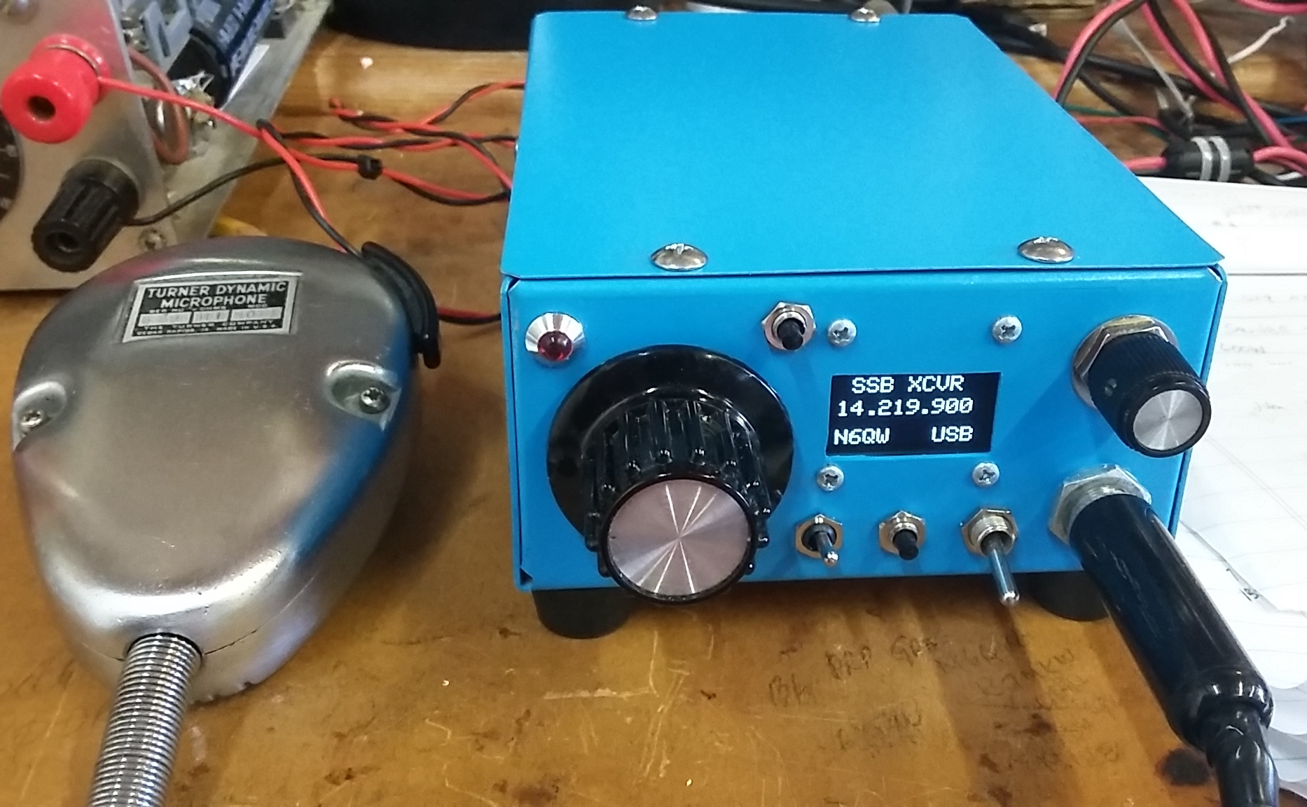
A really compact 5 Watt SSB Transceiver with OLED Display

Slide 25
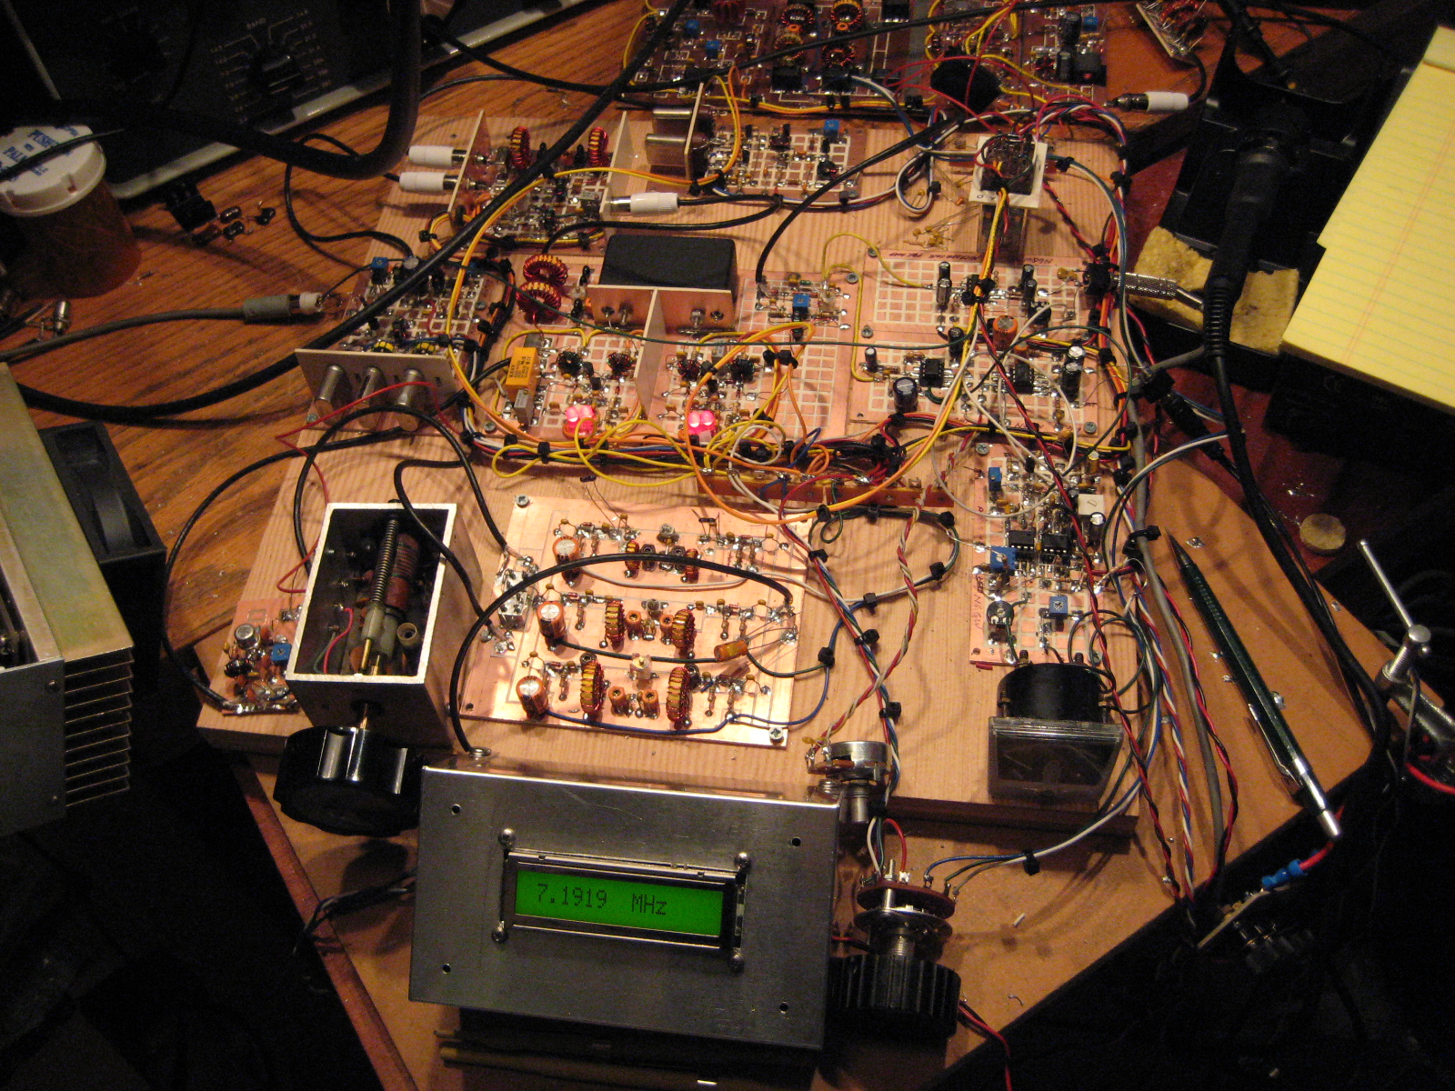
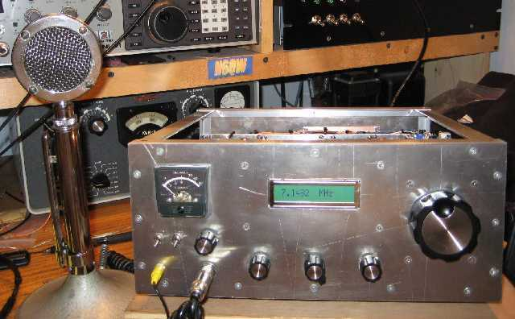
A Breadboard of the Tri-Band SS HW-101 circa 2009

Slide 26
Thank You for the Invitation to Present to your Club!
It has been a delight to visit with The Cedar Valley ARC to
share some of my homebrew adventures. I do “smoke” a
lot of parts and not all my projects are successful from
the outset. I once had a project that took me nearly 3 years
to fix. It was a broken pin inside a tube socket. At the pin
base you would measure a voltage but it wasn’t getting to the
tube itself. I leave you with: The sometimes obvious is not so.
Now if there are any questions --- have at it.
21

Slide 27
http://www.n6qw.com (Current Projects)
http://www.jessystems.com (Old Projects)
http://www.n6qwradiogenius.us (SDR Rigs)
http://www.pastapete.com (Cooking Stuff)
22

